Slide 1
Travel & Tourism
Group – 9
Priyanshu Gupta
Madhav Madhukar
Ahana Bose
Vishakha
Mth – 208
PrOF: DOOTIKA VATS

Slide 2
UNRAVELING THE SIGNIFICANCE OF CHOOSING TRAVEL & TOURISM AS OUR PROJECT FOCUS-
Travel and tourism are essential components of the global economy. Analyzing data in this sector can lead to valuable insights with practical applications. For example, businesses can use statistical analysis to optimize pricing strategies, improve customer satisfaction, or enhance operational efficiency.
Tourism is a major contributor to India's GDP, providing substantial revenue and employment opportunities providing jobs directly and indirectly in sectors like hospitality, travel agencies, tour operations, and related services. India's tourism industry has been steadily growing, with increasing numbers of domestic and international tourists. As disposable incomes rise and travel becomes more accessible to a larger population, the demand for tourism-related services is likely to continue growing. India is a diverse country with rich cultural heritage, historical landmarks, natural beauty, and vibrant cities. Companies can capitalize on this diversity by offering various tourism-related services, catering to different preferences and interests of tourists. Investments in infrastructure, such as hotels, resorts, transportation, and entertainment facilities, can enhance the overall tourism experience. Companies involved in infrastructure development can also find ample opportunities in the growing Indian tourism market.

Slide 3
PROBLEM STATEMENT
Dr. Dootika Vats is thinking of opening a travel and tourism based company in India. She wants to know the secret ingredient to make it a hit. We, the people of Group 9 Consulting Pvt Ltd are going to help her find that. We would like to provide compelling reasons why this decision could be a complete game changer for her organization. Her investment has the potential not only to yield profitable returns but also to make a positive difference in the lives of millions while aligning with the global trends shaping the future of travel and tourism.

Slide 4
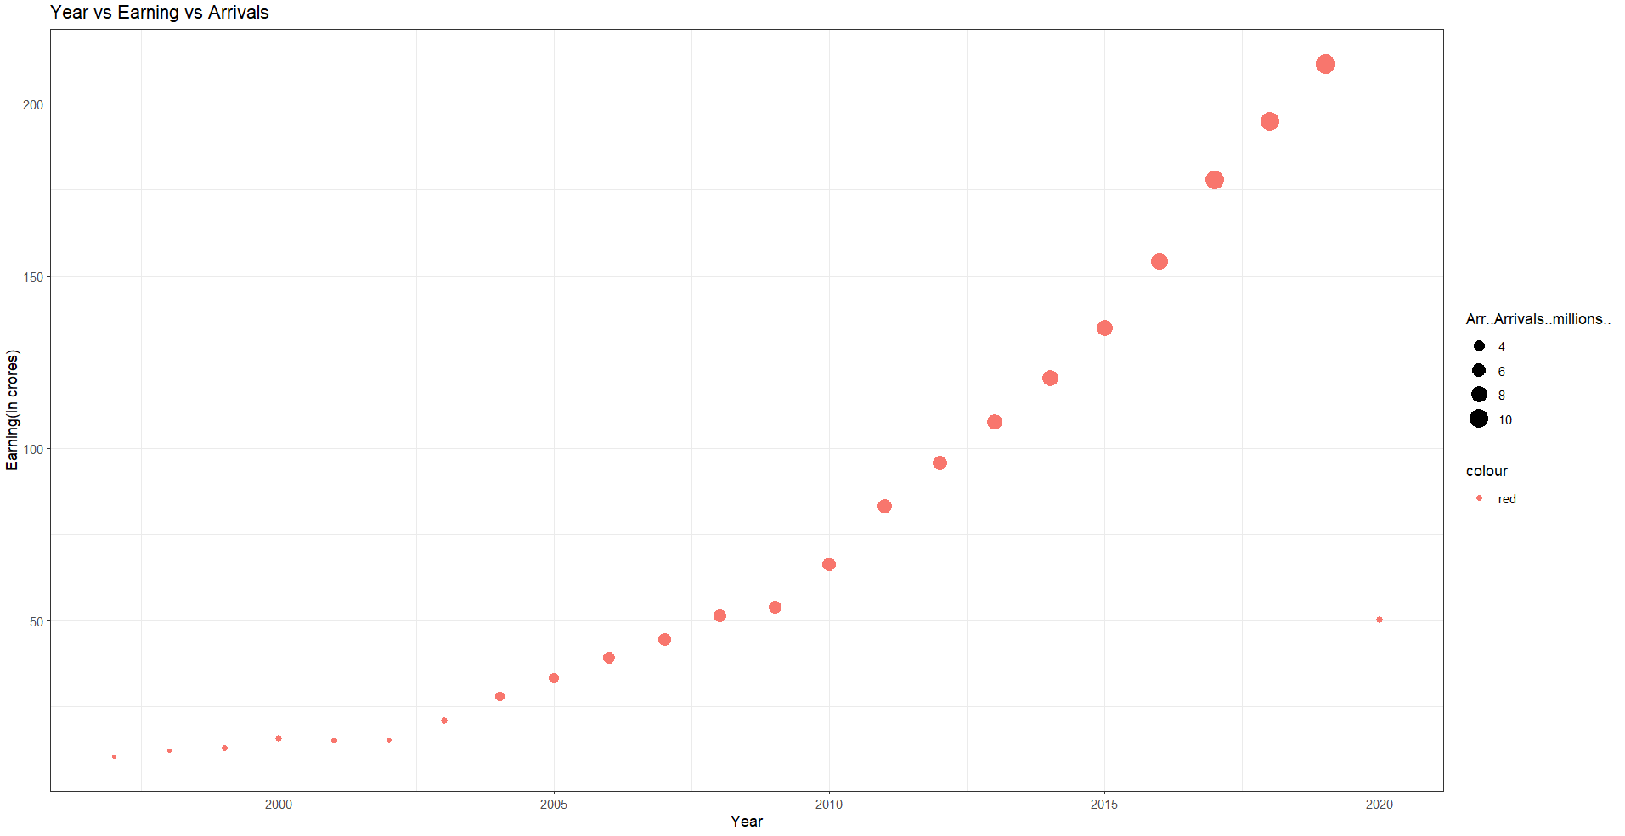

Slide 5
We can see from the graph that as time increases the foreign exchange earnings increases along with the number of foreign tourists arriving in India from 1997 to 2019.
However, there is a sudden depression in the year 2020. Due to COVID, the number of foreign tourists arriving in India decreased, resulting in significant drop in earnings. As things got better, the number of arrivals is expected to increase.

Slide 6
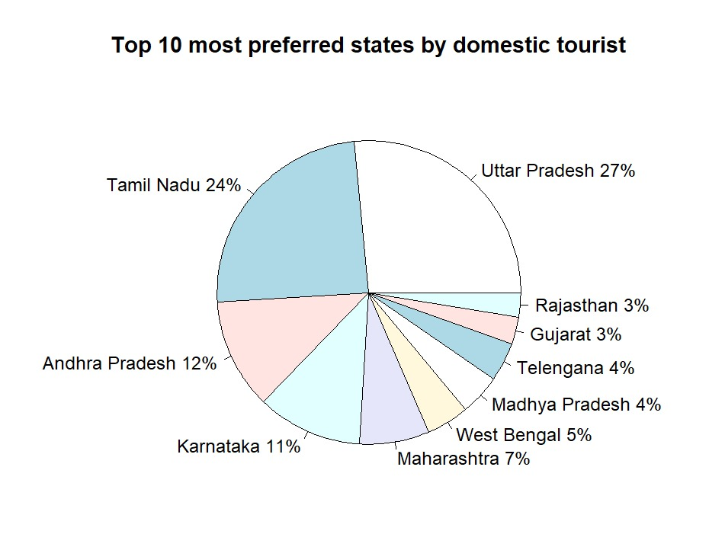

Slide 7
The most popular tourist destinations among domestic travellers are-
UTTAR PRADESH (27%)
TAMIL NADU (24%)
ANDHRA PRADESH (12%)
KARNATAKA (11%)
MAHARASHTRA (7%)
WEST BENGAL (5%)
MADHYA PRADESH (4%)
TELENGANA (4%)
GUJARAT (3%)
RAJASTHAN (3%)

Slide 8
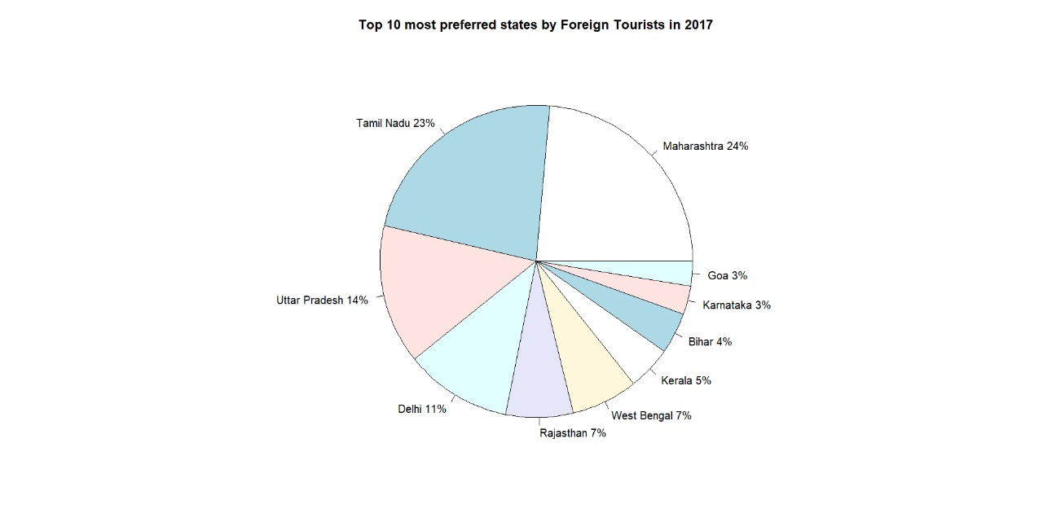
TOP 10 STATES/UTs OF INDIA IN NUMBER OF FOREIGN TOURIST VISITS -

Slide 9
The most popular tourist destinations among foreign travellers are-
MAHARASHTRA (24%)
TAMIL NADU (23%)
UTTAR PRADESH (14%)
DELHI (11%)
RAJASTHAN (7%)
WEST BENGAL (7%)
KERALA (5%)
BIHAR (4%)
KARNATAKA (3%)
GOA (3%)

Slide 10
We can say that the top destinations preferred by both domestic and foreign tourists are –
Maharashtra, Tamil Nadu, Uttar Pradesh, Karnataka and Delhi. These states attract a significant majority of foreign and domestic tourists. Investments in infrastructure, hospitality and promotional activities can be concentrated in these regions to enhance the overall tourist experience.
While the top destinations are crucial, it’s also important to diversify marketing strategies to attract tourists to other states. Creating unique and appealing packages, highlighting cultural and natural attractions and promoting offbeat destinations in states like Rajasthan, West Bengal, etc can help increase their popularity among the travellers. Investments in tourism infrastructure, such as hotels, transportation, and recreational facilities, should be made to accommodate the growing number of tourists. Ensuring a seamless and enjoyable travel experience can lead to positive reviews and repeat visits.

Slide 11
CONTRIBUTION OF TOURISM TO INDIA’S GDP-
Travel and tourism is one of India’s largest economic sectors, ranking eighth among the leading countries in terms of direct contribution to GDP. Tourism in India is 4.6% of the country’s gross domestic product (GDP). The World Travel and Tourism Council calculated that tourism generated ₹13.2 lakh crore (US$170 billion) or 5.8% of India's GDP and supported 32.1 million jobs in 2021. Even though, these numbers were lower than the pre-pandemic figures; the country's economy witnessed a significant growth in 2021 after the massive downturn during 2020. The sector is predicted to grow at an annual rate of 7.8% to ₹33.8 lakh crore (US$420 billion) by 2031 (7.2% of GDP). Most of the tourism revenue in India comes from domestic tourists. However, India has witnessed an exponential rise in foreign exchange earning since 2000, along with an increased inflow of foreign tourists into the country.

Slide 12
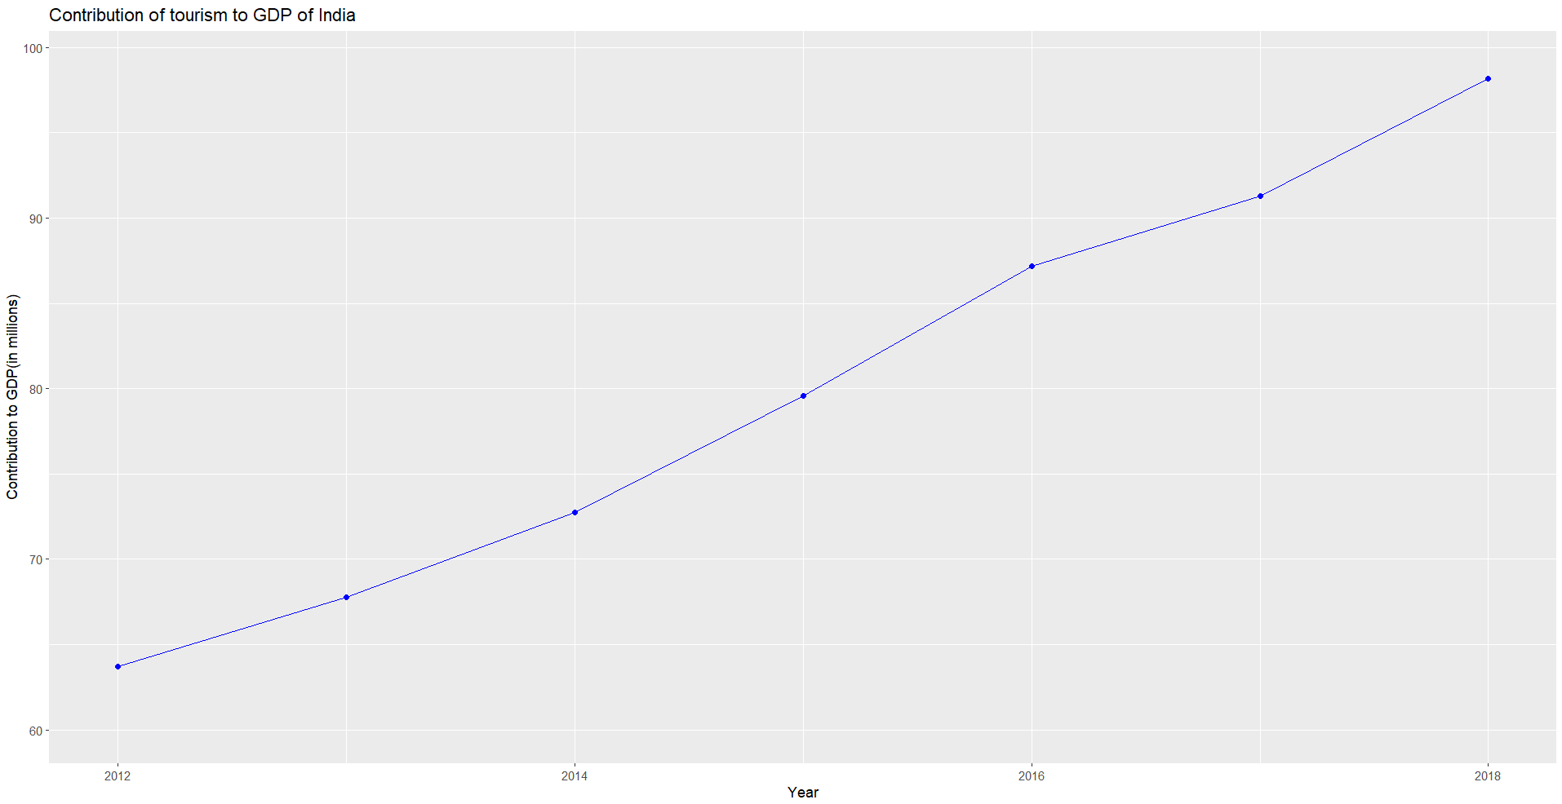
CONTRIBUTION OF TOURISM TO GDP-

Slide 13
Over the years the contribution of tourism to India’s GDP (Gross Domestic Product) has increased significantly indicating positive trend.
Some possible inferences that can be drawn are-
Economic Growth: A rising contribution of tourism to GDP suggests overall economic growth. Tourist spending on accommodation, food, transportation, and activities boosts various sectors of the economy, leading to increased GDP.
Employment Opportunities: The growth in tourism often leads to the creation of jobs in various industries such as hospitality, travel, entertainment, and local handicrafts. This, in turn, reduces unemployment rates and improves the standard of living for people.
Entrepreneurship and Small Businesses: Tourism encourages entrepreneurship, especially in the form of small businesses such as local tours, souvenir shops, and restaurants. These small businesses contribute significantly to the local economy and employment rates.

Slide 14
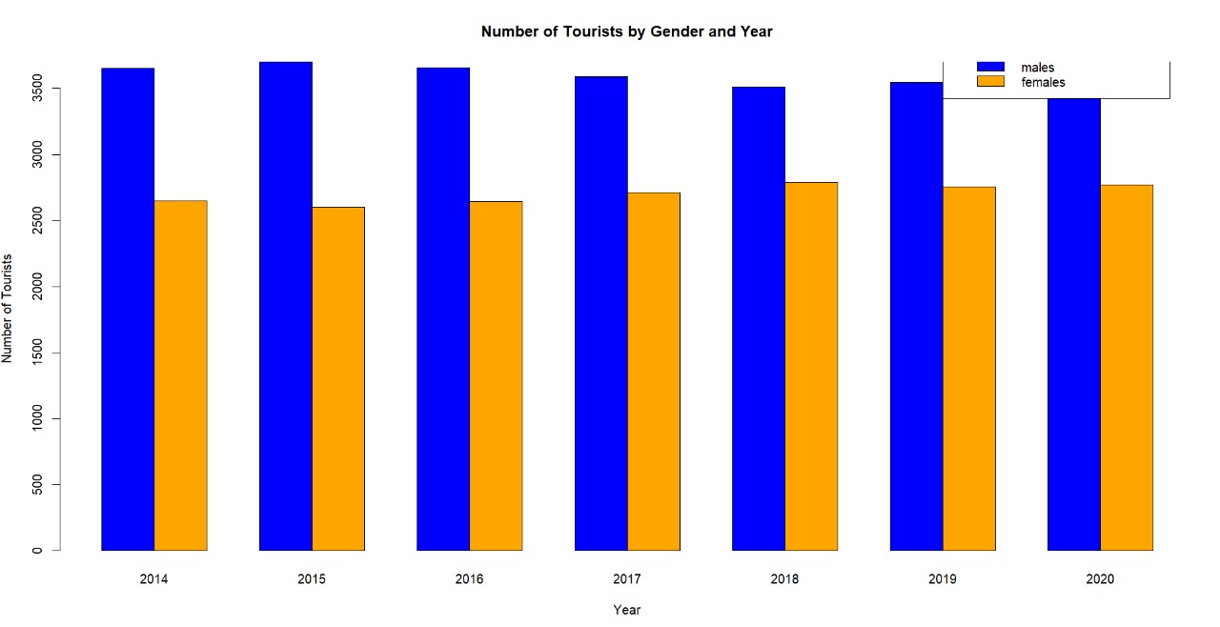

Slide 15
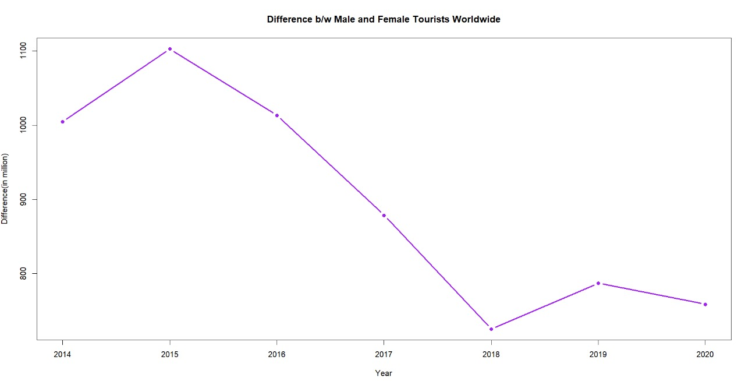

Slide 16
We can see from the sidewise barplot of male and female tourists that the number of males and females arriving in India from different countries has been almost constant from 2014-2020.
The stability in the number of tourists indicates that the tourism industry in India is resilient to external shocks and economic fluctuations. Despite global events or economic uncertainties, the flow of tourists remains steady, showcasing the stability of the tourism sector. A consistent number of male and female tourists suggests that India's attractions appeal to a diverse range of travelers. The country likely offers a variety of experiences, cultural attractions, historical sites, natural beauty, and other factors that are attractive to both genders.
The difference between male and female tourists’ plot shows previously there was a huge difference between the number of male and female tourists and over the years the difference has decreased. One positive interpretation could be that there is an improvement in gender equality, and more females are now traveling to India, potentially for work, education, or other opportunities. This could indicate a positive shift towards gender balance in various fields and activities..

Slide 17
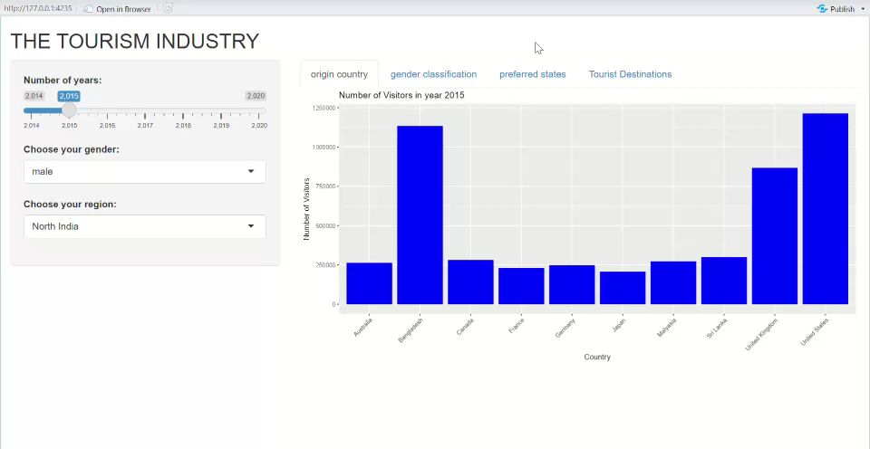

Slide 18

Wikipedia
Kaggle
Statista

Slide 19
THANK YOU

